Slide 1

Co = co : Co
Corecursion, Codata, and some Combinatorial Game Theory
by Carlos Rodrigues
@carlos1nsr

Slide 2



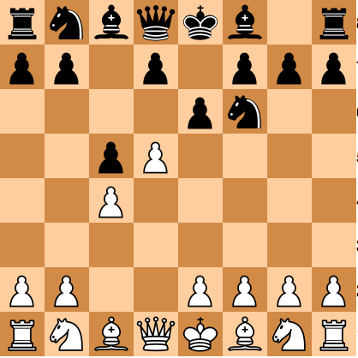
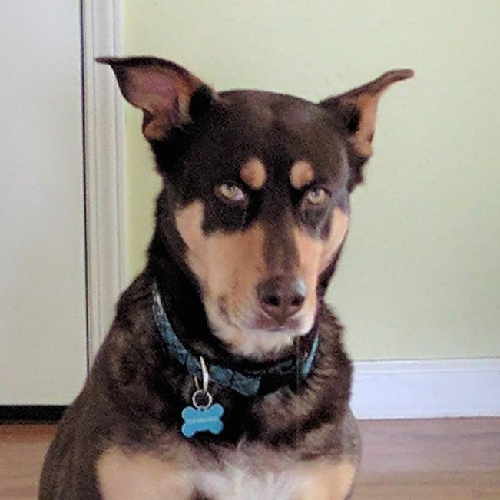
Who am I?
Portuguese South African
Live in Denver
Write Elixir for Blinker
Have dog: Molly
Chess player & Rock climber
Academic?

Slide 3

Why this Talk?
Interested in FP
Support LambdaConf
List of FP proficiencies
Corecursion sounds cool
Codata is related
Chess => game trees!

Slide 4
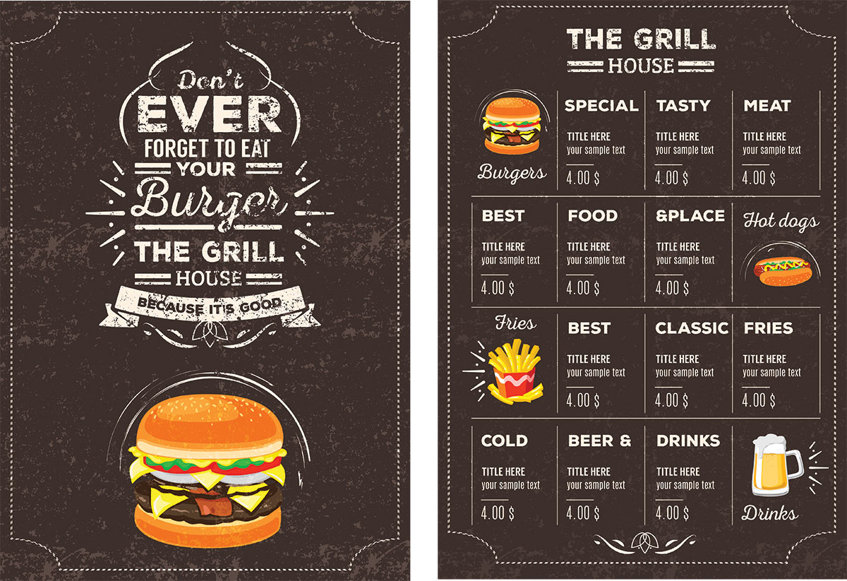
About this Talk
Corecursion
Codata
AI: minimax w/pruning
No GADTS (time)
No libraries (except Prelude)
No proofs
No bisimulation, coinduction
Examples in plain code

Slide 5
Concepts
Game Theory
Why codata & corecursion?
What is codata?
What is corecursion?
How to use corecursion to generate infinite data
What is minimax?
What is 𝜶𝞫-pruning?
Use co-co to generate game-trees

Slide 6
Why Codata & Corecursion?
Infinite lists (streams)
structuring programs
testing
modelling processes
approximations
Infinite trees
fractals
chemical structures
search spaces
Social
interview questions
bragging

Slide 7
Use infinite data? How?
Lazy Evaluation
Generating fn -> f
takes some input
returns infinite output
Consuming fn -> g
takes input from f
Strict synchronisation of f & g
f
starts when g reads input
runs only as long as needed
is then suspended
g runs until it needs more input
f is aborted when g terminates
g (f input)

Slide 8
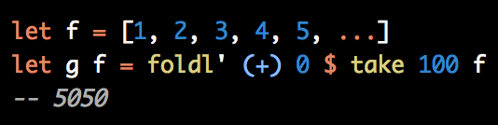
Implications of Lazy Evaluation
f is run as little as possible
f can be non-terminating
f can generate infinite data
g consumes the data
chooses which data to consume
chooses how much data to consume
terminates when done
f is forcibly killed when g is

Slide 9
What is Data?
What is Codata?
data type
finite
terminating
predefined, preconstructed
data type
(potentially) infinite
non-terminating
defines values in terms of themselves

Slide 10
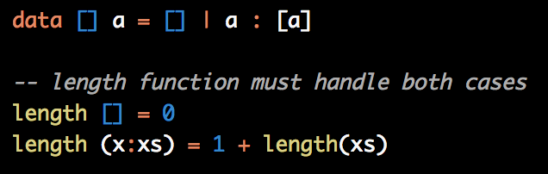
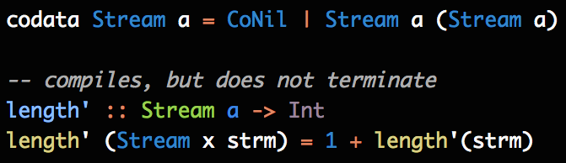
List
Stream
data type
finite
has a length
zero or more cons cells
ends in []
values independent from each other
only as much as you get
codata type*
infinite
no length
zero or infinite cons cells
no ending
each value is ‘successor’ of the previous value
as much as you want
* this type exists in Idris, not in Haskell

Slide 11


Types are defined by:
Introduction Rules & Elimination Rules
Introduction Rule
how it is created
makes objects of that type
functions that return the type
constructor is on the right of the equals sign
Elimination Rule
how it is consumed
allows using objects of that type
functions that take the type as a parameter
constructor is on the left of the equals sign

Slide 12


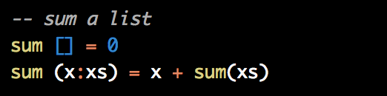

List
Stream
Introduction:
Apply constructors
Elimination:
Well-founded recursion
Elimination:
Pattern matching
Introduction:
Corecursion

Slide 13

What is Corecursion?
The Dual of Recursion

Slide 14


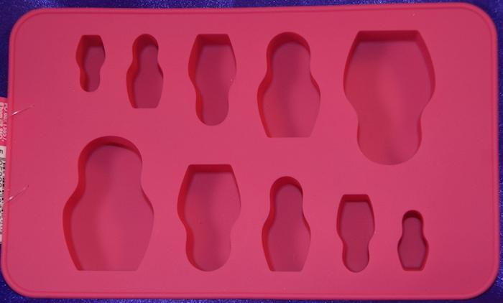
Recursion
Corecursion

Slide 15
Recursion
Corecursion
must always terminate
analytic
start big
reduce down to a base case
consumes a data type
Latin for “run back, return”
Properties
terminating base case
rules to reduce all other cases to that base case
spirals on and on from a seed
synthetic
start small
expand bigger and bigger
constructs a data type
“co” because it is the dual
Properties
starting base case (i.e. seed)
rules to produce all other cases from that base case

Slide 16
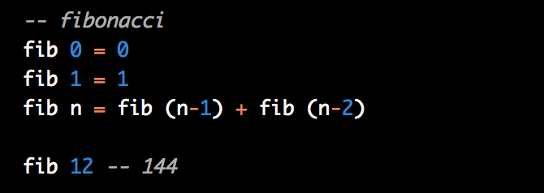
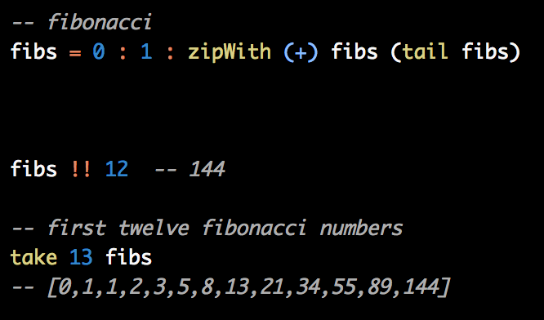

Recursion
Corecursion
Note:
solver
function
terminates
Performance: O(n!)
With memoization: O(n)
Note:
generator
constructor
non-terminating
Performance: O(n)
What?! How?
How many lists?
Surely, lists in lists in lists in lists...?

Slide 17

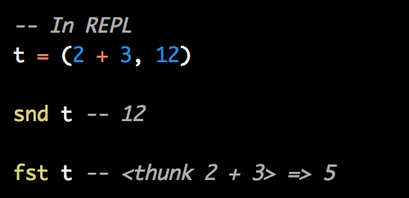
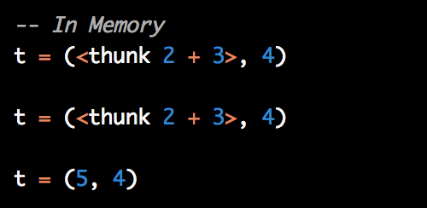
How does it work in O(n)?
Lazy Evaluation!
Quick general example:

Slide 18
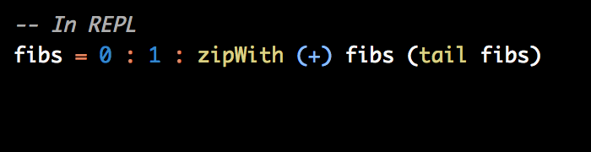
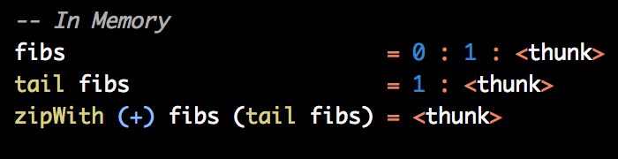

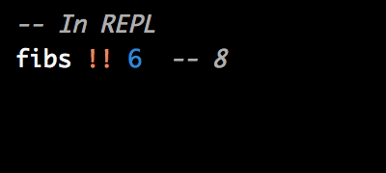
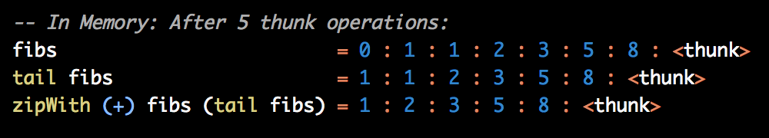

The Miracle Explained:
Magic Trick: That’s the same <thunk>!
Each reference is actually pointing to the same list!!!
Just shifted left once or twice
← Zero calculations done.
Answer is already in memory
Stats: O(n) additions
O(n) space

Slide 19


Creating your own infinitely repeating corecursions:
Pattern:
identifier
corecursive step
initial constructor (i.e. seed)
...or:
Pattern:
identifier
corecursive step
initial sequence of constructors
...or:

Slide 20

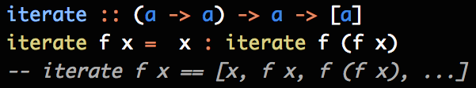

Creating your own successively changing corecursions:
Pattern:
identifier
corecursive step
initial constructor (i.e. seed)
...what about generic functions?

Slide 21
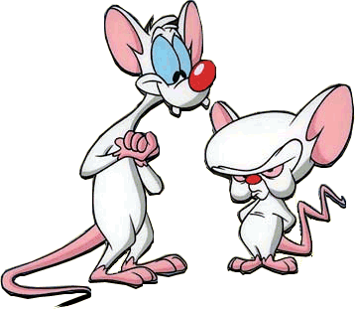

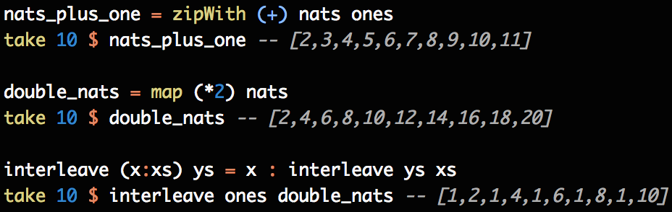
What else can one do with infinite lists?
Create new infinite lists
Or select only the values that one wants

Slide 22
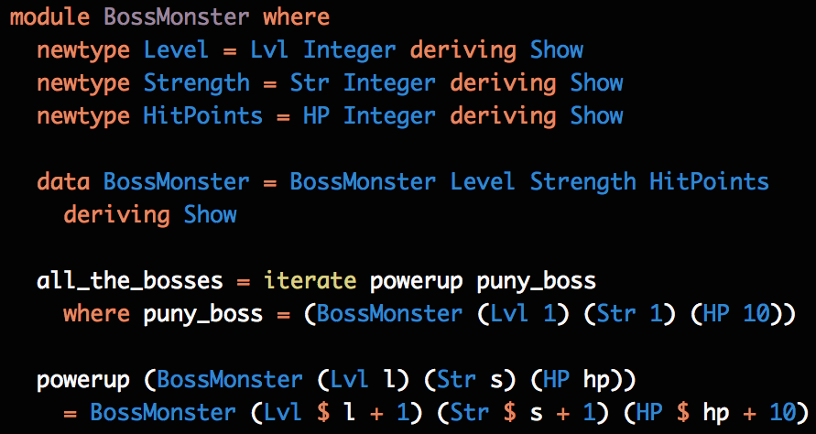

Creating your own successively larger boss monsters:
infinite list

Slide 23

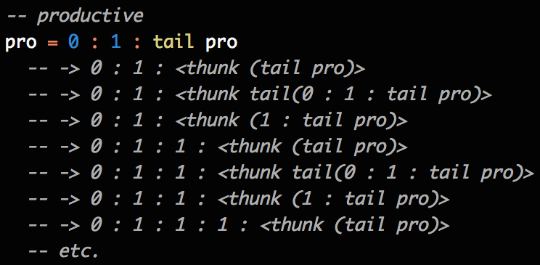
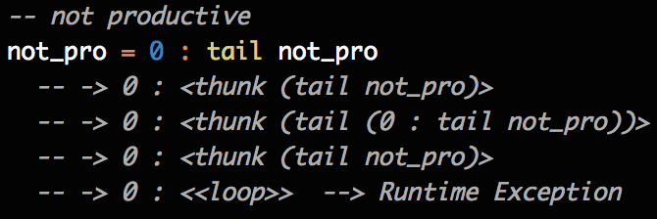

unproductive lists

Slide 24
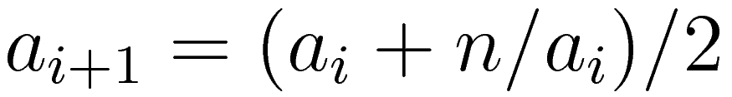
Non-trivial Example: Newton-Raphson Square Roots
number that we want the square root of
next approximation
approximation
Converges quickly to the answer a

Slide 25
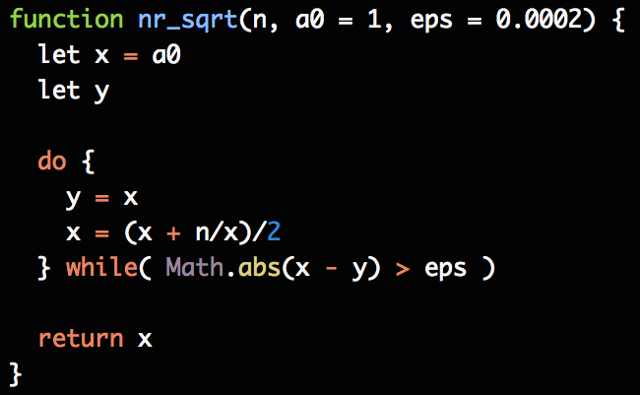
In Imperative Language:
Note: the generation of the approximation
is mixed into the logic

Slide 26
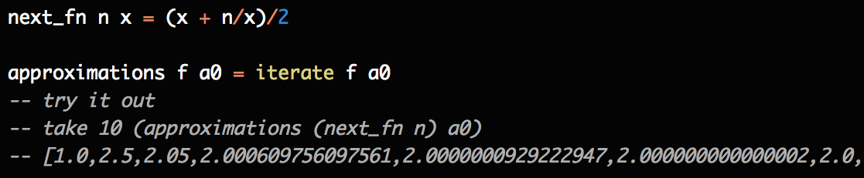
Use Corecursion!
The approximations are a list of successively applied functions to an initial value
corecursive step!
seed!

Slide 27
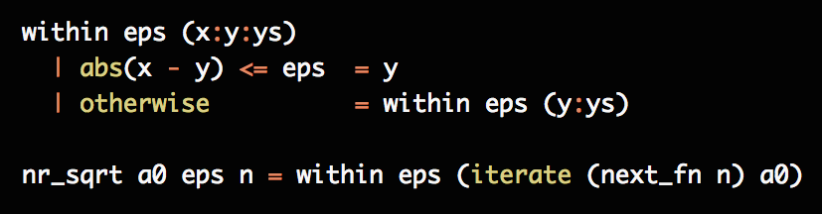
Write the consumer
We want an answer that is
within a certain tolerance

Slide 28
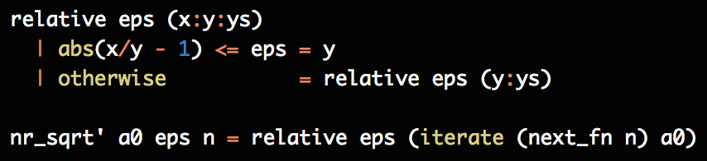
Woot!
Separating the generator from the logic simplified our solution
Can reuse the consumer or generator
Can swap out the consumer or generator

Slide 29
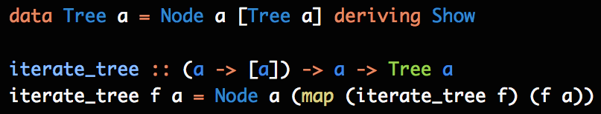
Creating your own infinite trees:
Reminder:
initial constructor (i.e. seed)
corecursive step
Pattern:
corecursive step
initial constructor (i.e. seed)

Slide 30

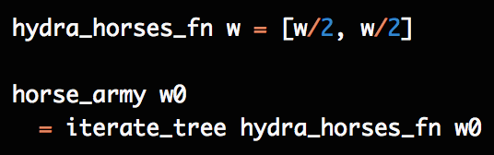
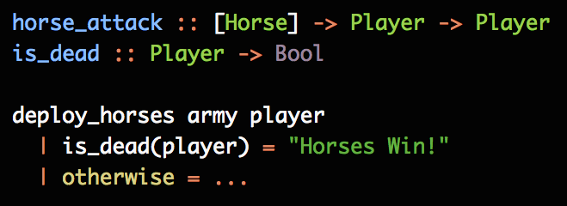
Tree Example:
Which is deadlier? One giant horse?
Or an infinite army of tiny horses?
Send waves of horses at a player until we find out!
800 lbs.
400 lbs.
400 lbs.
200 lbs.
200 lbs.
200 lbs.

Slide 31
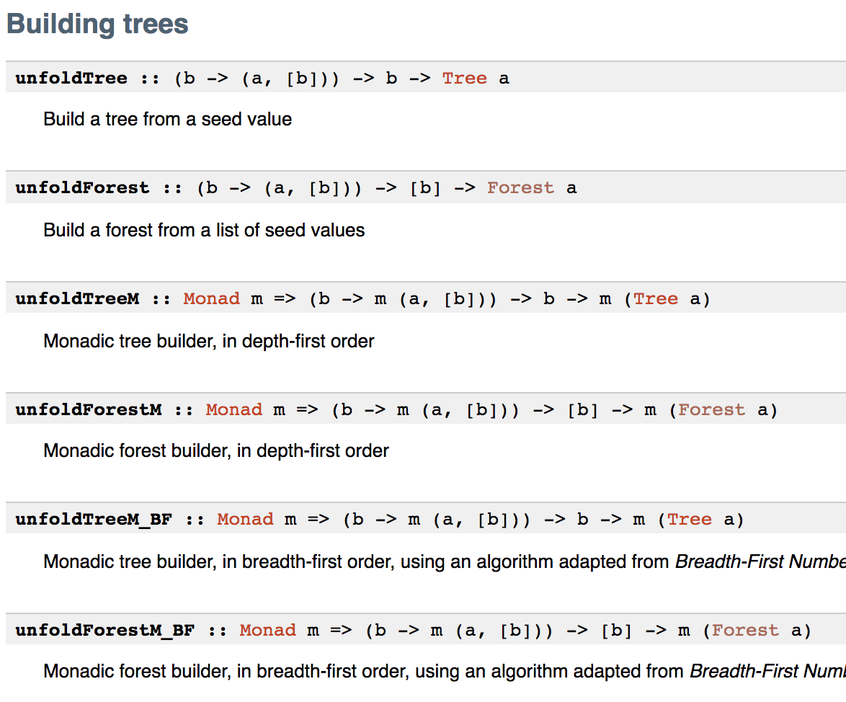
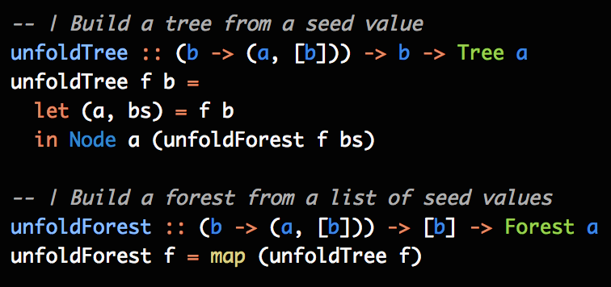
Data.Tree
Has support for infinite trees

Slide 32

Concepts
Game Theory
Why codata & corecursion?
What is codata?
What is corecursion?
How to use corecursion to generate infinite data
What is minimax?
What is 𝜶𝞫-pruning?
Use co-co to generate game-trees

Slide 33
Minimax
Combinatorial
Game Theory
Assume 2 players, MIN and MAX
trying to maximise the result for MAX
trying to minimise the result for MIN
Search tree of possible states for each player
each state has a utility value
negative value favours MIN
positive value favours MAX
On each layer of the tree, alternate
seek maximum result for MAX
seek minimum result for MIN
Goal: Optimal solution over a search space of states and actions.
s0 : initial state of the game
a(s) : possible actions at that state
r(s,a) : resultant state after applying
that action at that state
u(s) : the utility of that state
Goal: maximise the worst-case outcome
for Max

Slide 34
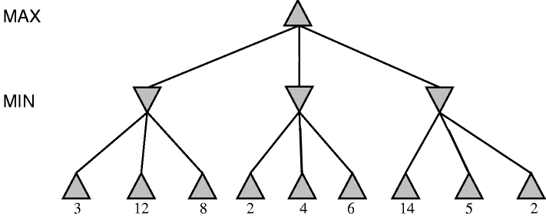
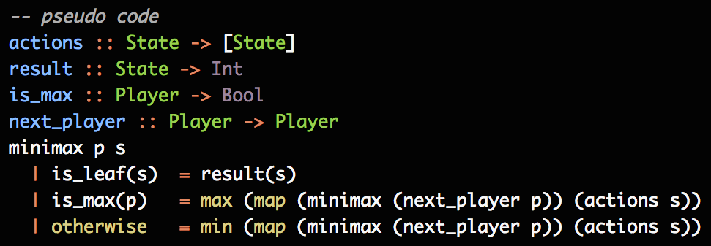
Minimax

Slide 35
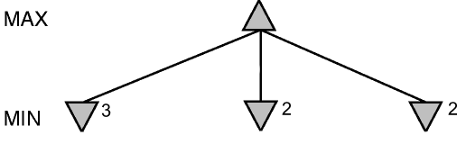

Minimax
MAX’s Turn
Assume MIN will pick the least utility
MIN’s Turn
MAX will pick the most utility

Slide 36
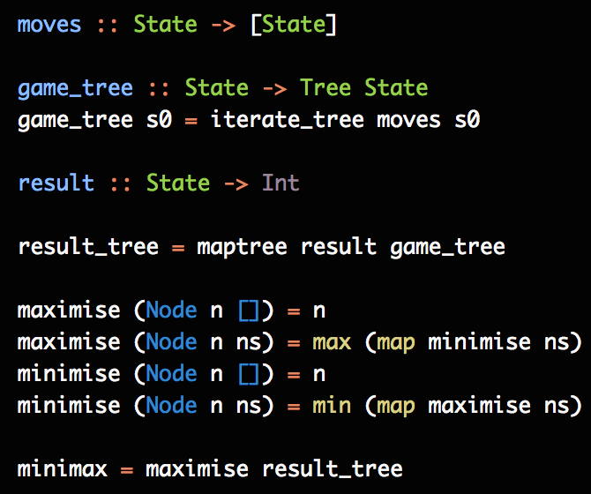
Minimax
Problems
Solutions
(potentially) infinite tree!
can get large quickly
X’s & O’s: 9! states
traverse to a set depth
ignore portions that don’t affect the outcome (𝜶𝞫-pruning)

Slide 37
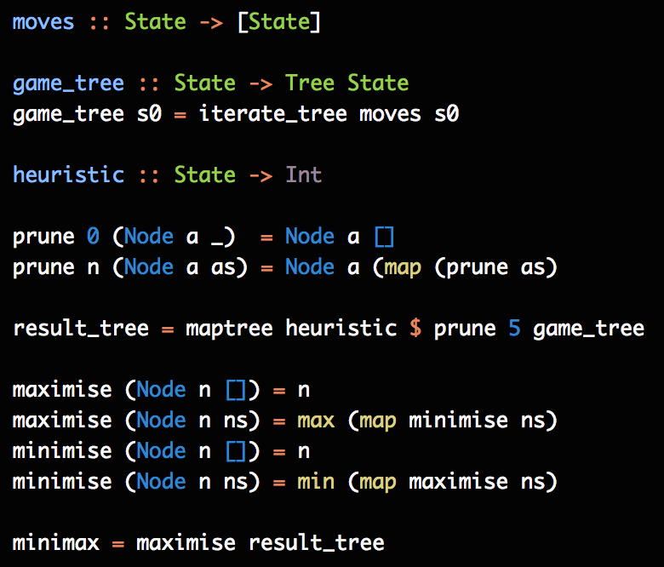
Traverse to
Depth n
only consider the next n layers
use heuristic to approximate the true value of the position

Slide 38
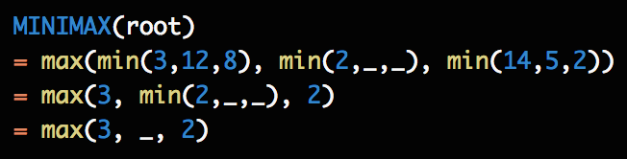
𝜶𝞫-Pruning
ignore branches that won’t affect the outcome

Slide 39
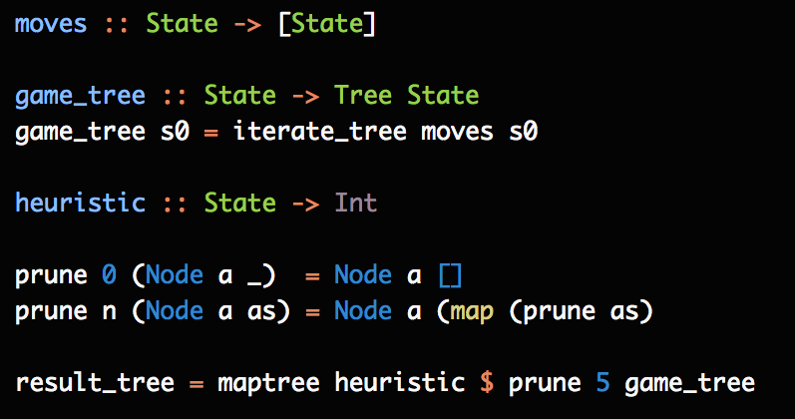
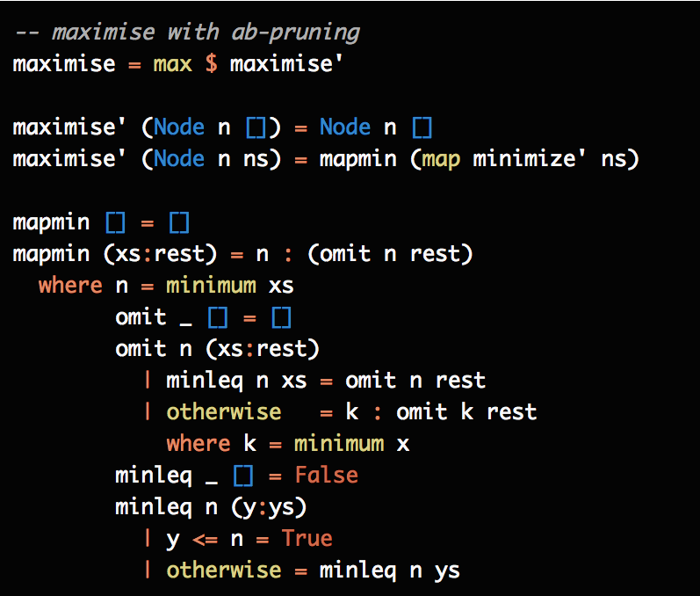
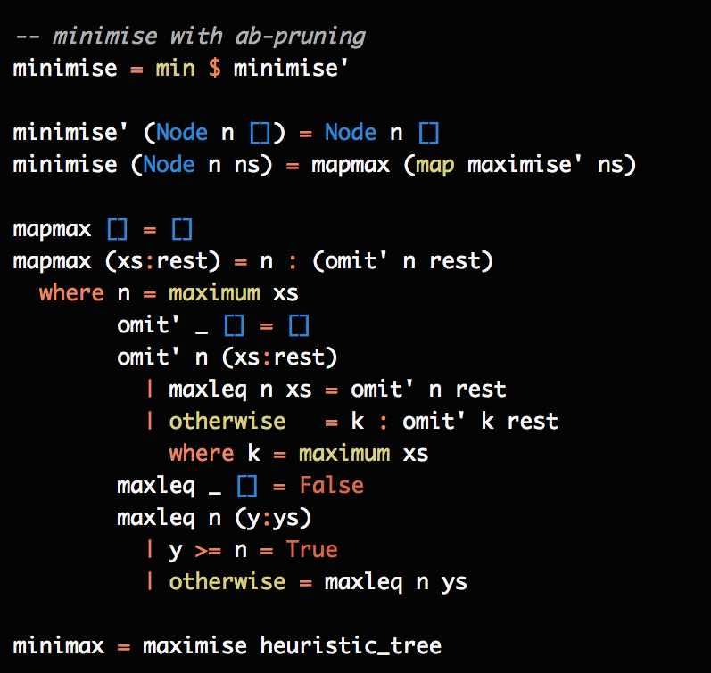
Minimax w/𝜶𝞫-pruning

Slide 40
Concepts
Game Theory
Why codata & corecursion?
What is codata?
What is corecursion?
How to use corecursion to generate infinite data
What is minimax?
What is 𝜶𝞫-pruning?
Use co-co to generate game-trees

Slide 41
Sources and Credits
Benjamin F. Jones
John Hughes
H. Abelson & G. J. Sussman
Kees Doets & Jan van Eijck
Stuart Russell & Peter Norvig
Michael Maloney
mguica
"Alpha-Beta Pruning"
"Why Functional Programming Matters"
"Structure and Interpretation of Computer Programs"
”The Haskell Road to Logic, Maths and Programming. (2nd Ed,)”
“Artificial Intelligence: A Modern Approach (3rd Ed,)”
“Data vs Codata”
"Stack Overlflow: Understanding a recursively defined list"

Slide 42
Thank You
Corecursion, Codata, and some Combinatorial Game Theory
by Carlos Rodrigues
@carlos1nsr

